Slide 1
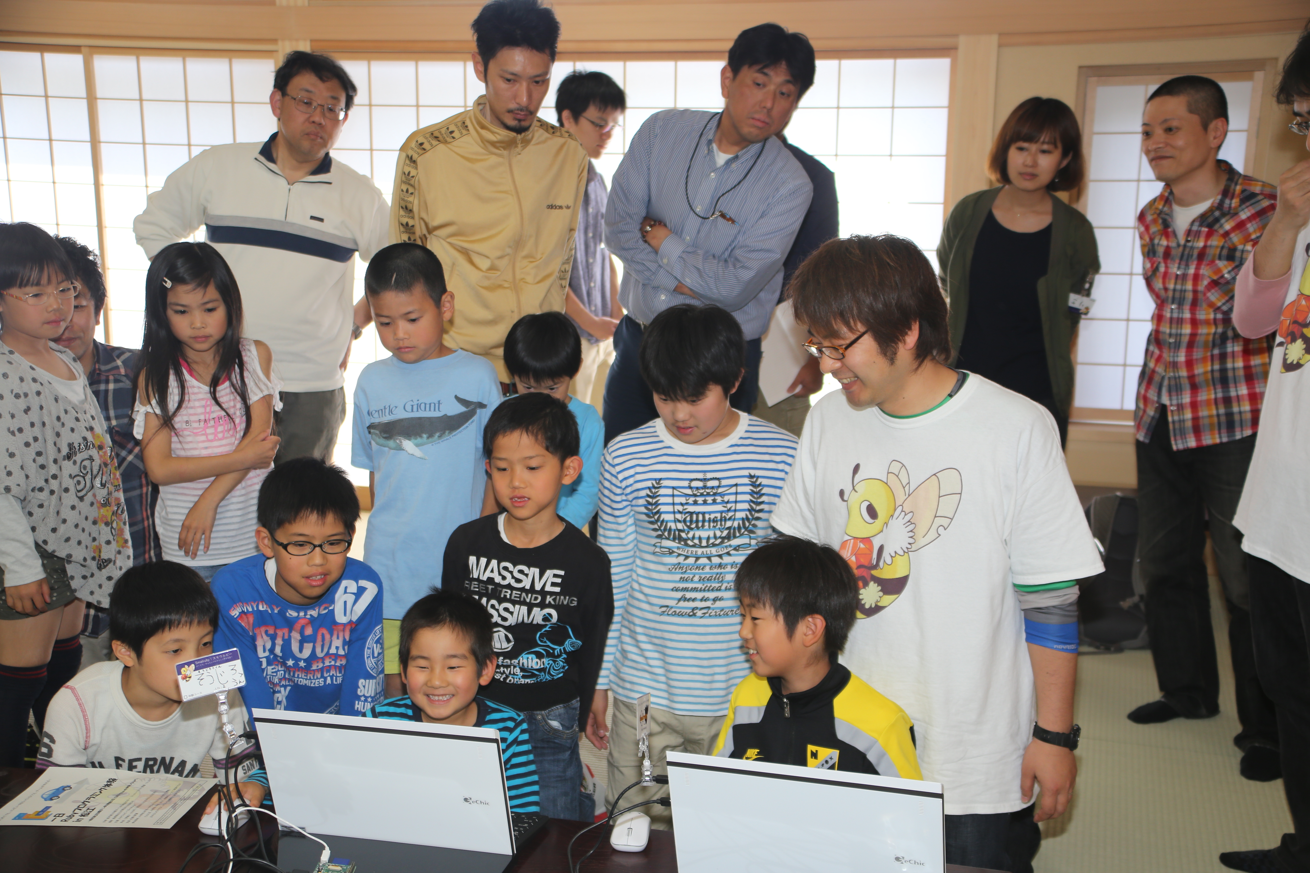

Kids Fun Ruby!
Introduction of the Smalruby and the Ruby Programming Shounendan
Kouji Takao and Nobuyuki Honda,
The Ruby Programming Shounendan,
RubyKaigi 2014, 09.19.2014

Slide 2
Kouji Takao
A leader of the Ruby Programming
Shounendan, CRuby commiter
kouji@smalruby.jp
@takaokouji
高尾 宏治
Nobuyuki Honda
A chief education officer of
the Ruby Programming shounendan
nobyuki@smalruby.jp
@nobyuki
本多 展幸

Slide 3
Nobuyuki Honda
A chief education officer of
the Ruby Programming shounendan
nobyuki@smalruby.jp
@nobyuki
本多 展幸
Kouji Takao
A leader of the Ruby Programming
Shounendan, CRuby commiter
kouji@smalruby.jp
@takaokouji
高尾 宏治

Slide 4
Sponsored by
NaCl
Nobuyuki Honda
A chief education officer of
the Ruby Programming shounendan
nobyuki@smalruby.jp
@nobyuki
本多 展幸
Kouji Takao
A leader of the Ruby Programming
Shounendan, CRuby commiter
kouji@smalruby.jp
@takaokouji
高尾 宏治

Slide 5
NaCl is
SIer

Slide 6
NaCl has
30
Rubyists

Slide 7
NaCl has
6
Commiters

Slide 8
Please
come to
visit out
NaCl♪

Slide 9
Kids Fun Ruby!
Introduction of the Smalruby and the Ruby Programming Shounendan
Kouji Takao and Nobuyuki Honda,
The Ruby Programming Shounendan,
RubyKaigi 2014, 09.19.2014

Slide 10
The Ruby
Programming Shounendan
Rubyプログラミング少年団

Slide 11
Ruby programming event for young people and parent
1日Rubyプログラミング体験 in 松江
毎月第３日曜日
Introduce ruby
Once a month

Slide 12
The Ruby Programming Shounendan
Rubyプログラミング少年団
Team
チーム
≒
Contest
大会
Coach
コーチ
Boy scout for
Ruby programming
Rubyを対象としたスポーツ少年団

